Slide 1
Workshop
Andrea Acquaroni
4/3/2011 Microsoft TVP Reading

Slide 2
boxedUC

Slide 3
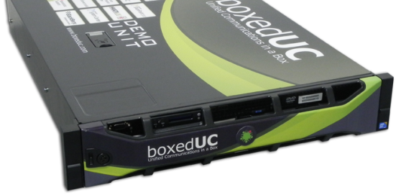
What is boxedUC?
boxedUC is an innovative “appliance as a service”
Extended Cloud
Single server
Remote services
On-premise deployment
Monitoring
Full Microsoft UC
Update
Plug’n’Play
Security
Self-Management tools
Technical Support
Appliance Governance System
Notes:
BoxedUC is an appliance as a service. The innovation we’ve introduced is in this statement in which we find the word APPLIANCE and the word SERVICE, normally connected with different ways to run IT systems.
APPLIANCE: we have a (CLICK) Single server which will be deployed (CLICK) on customer’s premises through wich will be provided (CLICK) all the Unified Communications services from Microsoft. As it’s an appliance, it engineered to be (CLICK) Plug’n’Play, so very smart and quick to be set up, and it’s provided with (CLICK) smart self-management tools – dev by FD - allowing the customer to manage end-user resources by himself and (CLICK) a system which takes care of the health of the system, developed by FD and calle AGS.
SERVICE: boxedUC introduces a model, typical of «in the cloud» services; thanks to a stack of (CLICK) remote services, provided by infrastructures co-located in professional IDCs and by a skilled staff of engineers, boxedUC could be considered by the customer a sort of BLACKBOX; in this way the customer will have an experience similar to the SaaS / In the Cloud services which allows him to concentrate on his core business and forget the issues connected to running an IT infrastructure (which normally is not the core business of the client).
Thanks to this services, which are called ‘the Extended Cloud’, the appliance is, even if deployed on customer’s premises, (CLICK) monitored H24x365 , (CLICK_ CLICK) Updated constantly with security critical patches and application fixes and updates; The partner will access to a specialistic live support, in ITIL standard, helping to fix any issue.

Slide 4
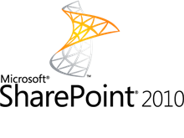
Microsoft Technology
Hyper-V
Windows 2008 R2 Ent/Data Center Edition
Notes:
Microsoft Technology
Wave 14
Hyper-V

Slide 5
Engineering
DMZ / FRONT-END NETWORK
RV. PROXY
EX2010
CAS
LYNC FE
…
FIREWALL
BACK-END
AD
EX2010 MBX
LYNC
FE
…
Hypervizor
AGS - ORCHESTRATION SERVICE
AGS - SERVICE CONSOLE
Notes:
- Pre configured Hypervizor on W2008 R2 ent/dc
Networking / Firewaiilng (security) -> Stand alone, behind a fw… no overlap, no NAT issues etc
- UC Farm - Best practices for MSFT UC
AGS – Orchestration Service (See Afer)
AGS- Service Console (See After)

Slide 6
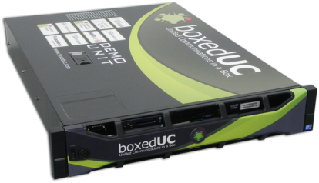
Appliance Governance System
SECURITY PATCHING
PATCHING
Extended Cloud
REMOTE MONITORING
SUPPORT
SERVICE CONSOLE
LOCAL MONITORING
boxedUC
ORCHESTRATION SERVICE
Notes:
THANKS AGS -> boxedUC NOT A STANDARD DEPLOYMENT
BUT = FULLY MANAGED ENVIROMENT = BLACKBOX FOR THE CUSTOMER
AGS = LOCAL SOFTWARE + REMOTE SERVICES
LOCAL SOFTWARE
- ORCHESTRATION SERVICE
- LOCAL MONITORING
- SERVICE CONSOLE
EXTENDED CLOUD (REMOTE SERVICE AS A aaS SOLUTION)
- SECURITY CRITICAL PATCHING
- PATCHING (UP-TO-DATE)
- REMOTE MONITORING (FROM THE OUTSIDE)
- SPECIALISTIC SUPPORT

Slide 7
Self-Management and provisioning
Active
Directory
resources
user
WEB CONSOLE
MOBILE
SDK / XML
Notes:
Target is to make easier for the cutomer to use UC technology.
Interaction with boxedUC MUST be very smart and must no required skills.
MultiUX, developed by FD and embedded in bUC, is a software which integrates the management of all servers of the architecture providing easy of access tools for the customer.
We have:
Web console
Mobile access for emergency operations
XML

Slide 8
Market

Slide 9
Sizing
SILVER
GOLD
250
500
+
High
Availability
Notes:
AGS makes boxedUC not a standard deployment of UC but a fully controlled anviroment – targeting the customer has to feel the bUC like a blackbox -.
AGS is composed by a stack of softwares and remote services managing the status of the appliance and of the whole services

Slide 10
Enterprise voice
Integration of local PSTN / PBX
Support for SIP trunks
Integrations of SIP phones
…
+
Support for Lync certified media gateway
Notes:
Cloud – no voice
Compatibility with all Lync-certified media gateways (citare il media by-pass?)

Slide 11
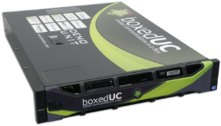
Branch offices
CORPORATE
UC
INFRASTRUCTURE
PSTN
Integrate quickly branch offices with standard Microsoft architecture
Integration of user identity ( Resource Forest Model )
Fast deployment
Run local enterprise voice

Slide 12
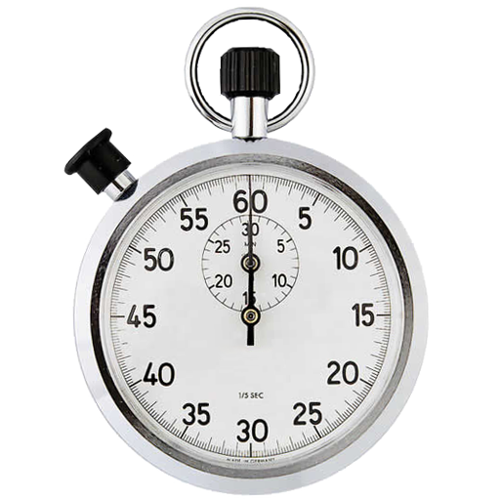
Proof of Concept
Fast deployment
Limited duration
Notes:
1) FAST DEPLOY
2) LIMITED DURATION

Slide 13
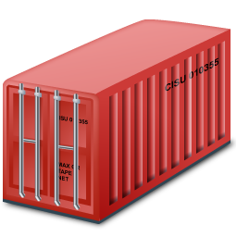
Local storage of data
Keep data on-premises
Match internal policies
Match law regulations
Notes:
KEEP DATA ONPREMISES
MATCH INTERNAL POLICIES
MATCH LAW REGULATIONS

Slide 14
Bypassing poor bandwith issues
In the CLOUD
CUSTOMER PREMISES
CUSTOMER PREMISES

Slide 15
Roadmap

Slide 16
Office 365 Mixed-Mode
Mixed-Mode between boxedUC and Office 365 allows to run UC services for the same customer on-premises and in the Cloud at the same time.
Customers will be able to deploy and move Exchange mailboxes and Lync users transparently from O365 and boxedUC transparently.
ON-PREMISES

Slide 17
Office 365 Mixed-Mode
Syncronization of users
Single Sign On
From MultiUx customer can administrate mailboxes and users both in boxedUC or in the Cloud
Enterprise Voice deployments (with local media gateway) are guaranteed by the on-premise boxedUC.
Local data storage for sub-set of mailboxes
ON-PREMISES
Notes:
SYNC USERS
SSO
MUX MANAGEMENT
ENETERPRISE VOICE BY ON-PREMISE
LOCAL DATA STORAGE FOR ON-PREMISE

Slide 18
boxedUC ‘LITE’
GOLD
Target: from few users to 100
SILVER
LITE
Lighter hardware
Configuration as SILVER model
Expected reduction of price: 40%
Now in internal R&D incubation

Slide 19
Partner Eco-System

Slide 20
Tech Partner Eco-System

